Slide 1
Module 4- Trees
Introduction
Terminology
Binary Trees
Properties of binary trees
Array and Linked representations of binary tree
Binary Tree Traversals
Additional Binary Tree Operations
Threaded Binary Trees
Binary Search Trees
Binary Search Trees operations
Application of Trees-Evaluation of Expression

Slide 2
Introduction (1/8)
Tree is a non-linear data structure used to represent hierarchical structure of data.
A tree G consists of a finite set of elements, called nodes, and a finite set of directed lines, called Branches, that connect the nodes.
If the tree is not empty, then the first node is called the root.
A tree may be divided into sub-trees. A sub-tree is any connected structure below the root.
The first node in a sub-tree is known as the root of the sub-tree

Slide 3
Introduction (2/8)
Definition (recursively): A tree is a finite set of one or more nodes such that
  There is a specially designated node called root.
  The remaining nodes are partitioned into n>=0 disjoint set T₁,…,T_{n}, where each of these sets is a tree. T₁,…,T_{n} are called the subtrees of the root.
Every node in the tree is the root of some subtree

Slide 4
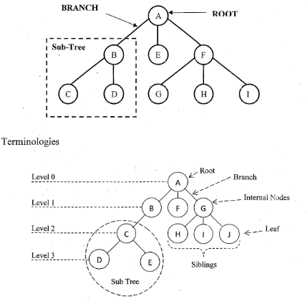

Slide 5
Introduction Terminology (3/8)
Degree of the Node : The number of subtrees of a node
Example: The degree of 'A' is 3, degree of 'B' is 1 and degree of 'D' is 0.
Degree of a tree: The maximum of the degree of the nodes in the tree.
Example: The degree of the above tree is 3.
Root Node-The first node at the top of the tree which does not have a parent is called as the root node.
Example: Node 'A' is the root node of the above tree.
Terminal nodes (or leaf): nodes that have degree zero or node with no successor . It is
node with no children.
Example: The nodes D, E, F, H, I and J are the leaf nodes of the above tree.
Nonterminal nodes: nodes that don’t belong to terminal nodes.
Example: The nodes A, B, C and-G are-the internal nodes of the above tree.
Parent and Children: Suppose N is a node in T with left successor S1 and right successor S2, then N is called the Parent (or father) of S1 and S2. Here, S1 is called left child (or Son) and S2 is called right child (or Son) of N.

Slide 6
Introduction (4/8)
Siblings: Children of the same parent are said to be siblings.
Example: The nodes D and E are siblings since they have the same parent C
Edge: A line drawn from node N of a T to a successor is called an edge
Path: A sequence of consecutive edges from node N to a node M is called a path.
Ancestors of a node: All the nodes along the path from the root to that node.
Example: Ancestors of D is C, B and A, Ancestors of H is G and A.
Descendants -The descendants of a node are all the nodes that are in its subtree.
Example: Descendants of B is C, D and E, Descendants of G is H, I and J
The level of a node: The distance of a node from the root is called as the level of the node. Example: The distance from the root node A to itself is 0
Height (or depth): The maximum level of any node in the tree
The height of a tree is defined as the maximum level of any leaf in the tree plus one.
Example: The maximum level of the above tree is three and hence the height of the above tree is four.

Slide 7
Introduction (5/8)
Example
  A is the root node
  B is the parent of D and E
  C is the sibling of B
  D and E are the children of B
  D, E, F, G, I are external nodes, or leaves
  B, C, H are internal nodes
  The level of E is 3
  The height (depth) of the tree is 4
  The degree of node B is 2
  The degree of the tree is 3
  The ancestors of node I is A, C, H
  The descendants of node C is F, G, H, I
Property: (# edges) = (#nodes) - 1
Level
A
1
B
C
2
H
3
D
E
F
G
I
4

Slide 8
Representation of Trees
There are three possible ways in which this tree can be represented.
  List Representation
  Left-child Right-sibling Representation
  Degree Two Tree Representation (Also called as Binary Tree Representation)

Slide 9
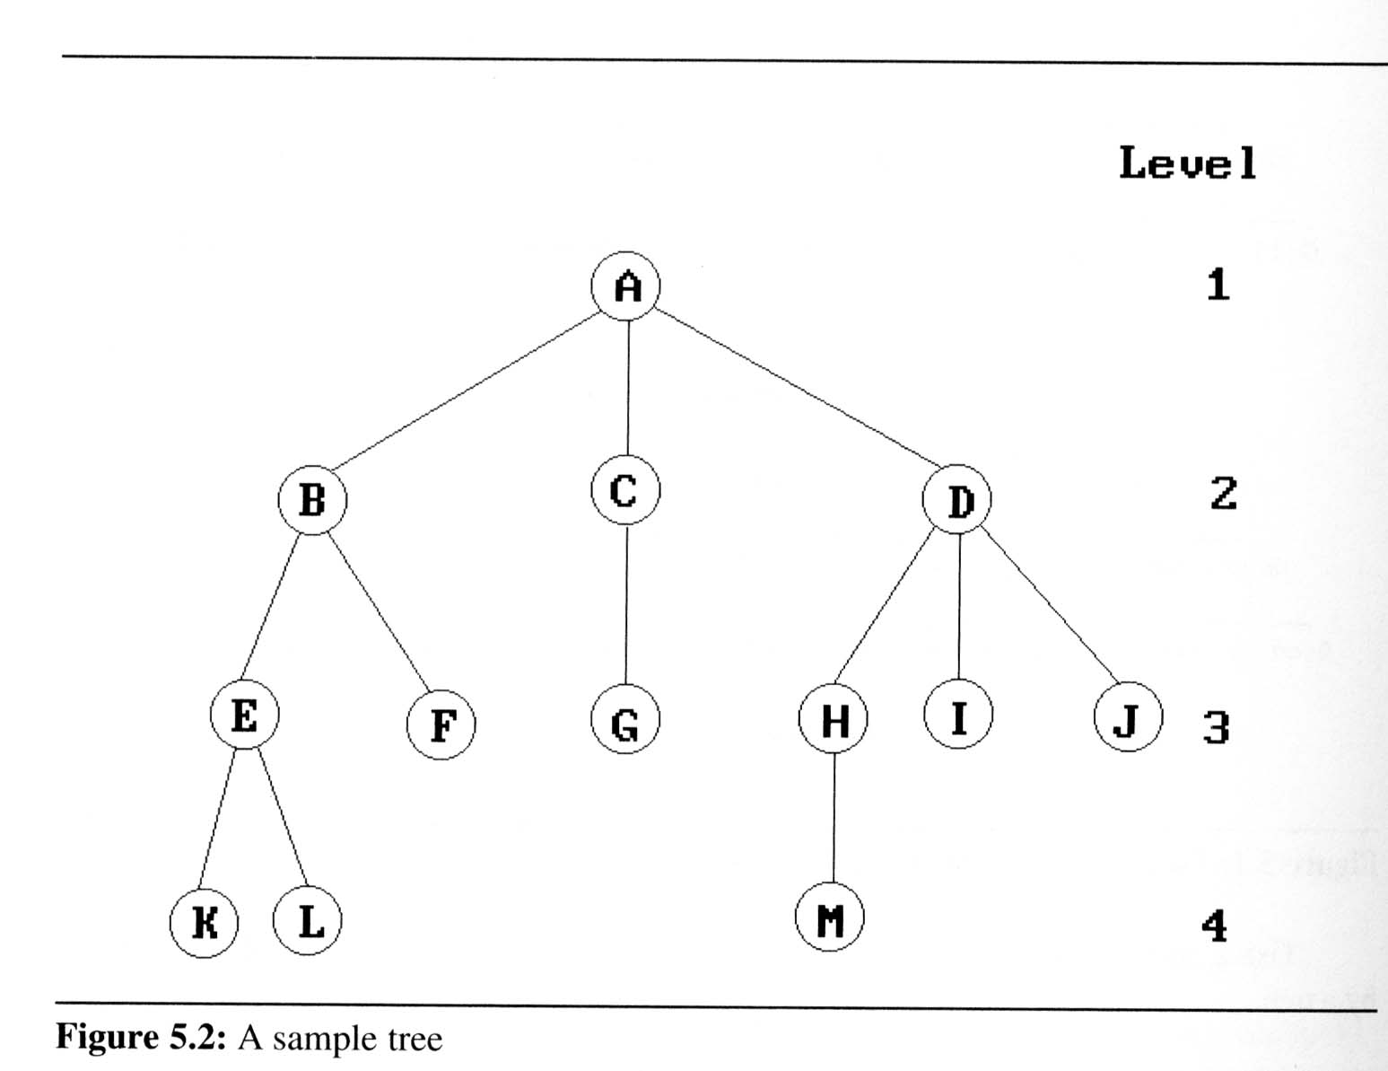
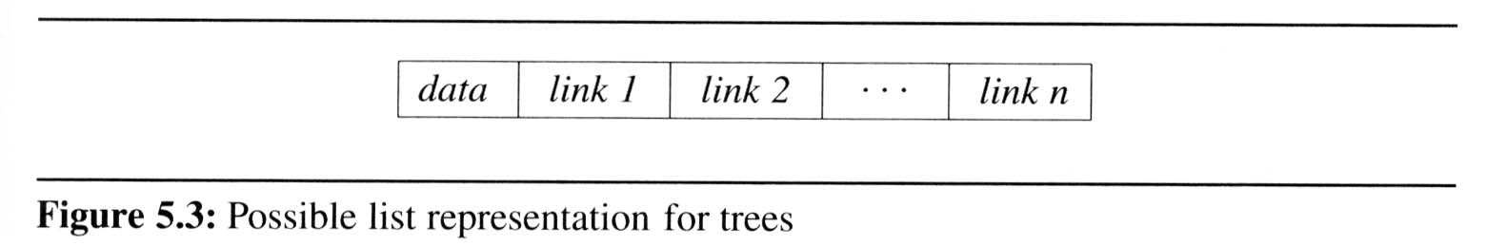
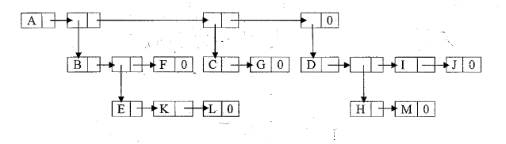
List Representation
The information in the root node comes first, which is immediately followed by. a list of sub trees of that node.
This is recursively repeated for each of the sub tree.
  ( A ( B ( E ( K, L ), F ), C ( G ), D ( H ( M ), I, J ) ) )
  Memory representation

Slide 10
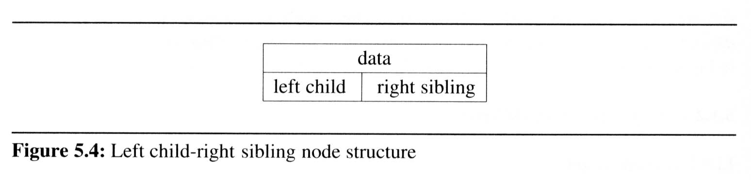
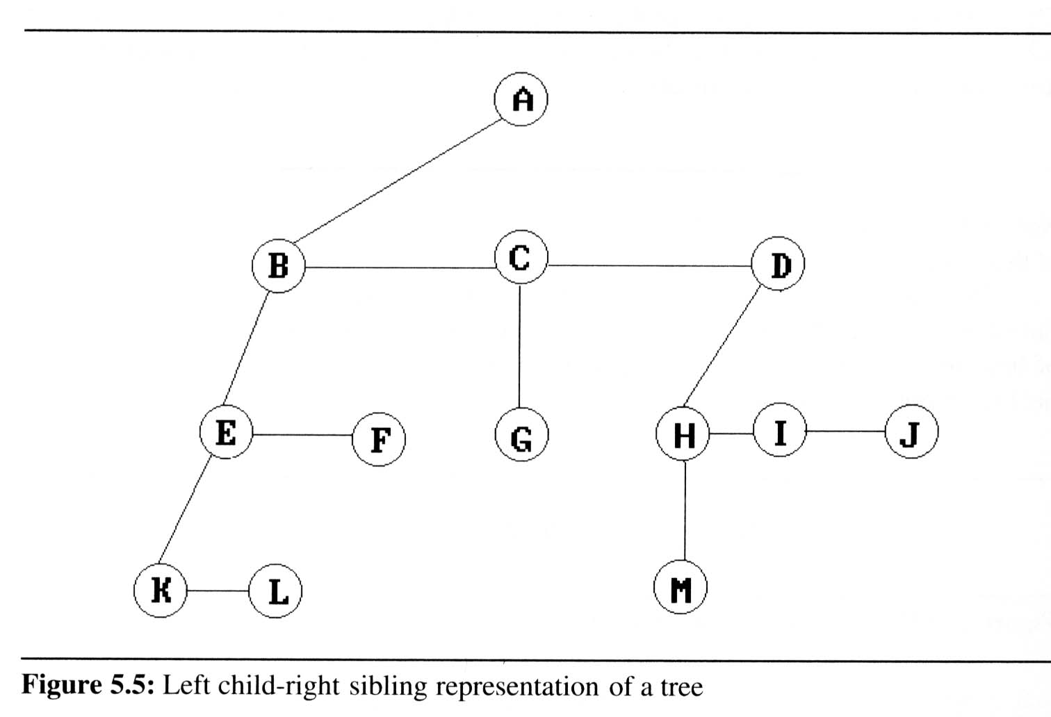
Left Child Right Sibling Representation
In this representation, the left pointer of a node in the tree will be the left child and the remaining children of the node will be inserted horizontally to the left child

Slide 11
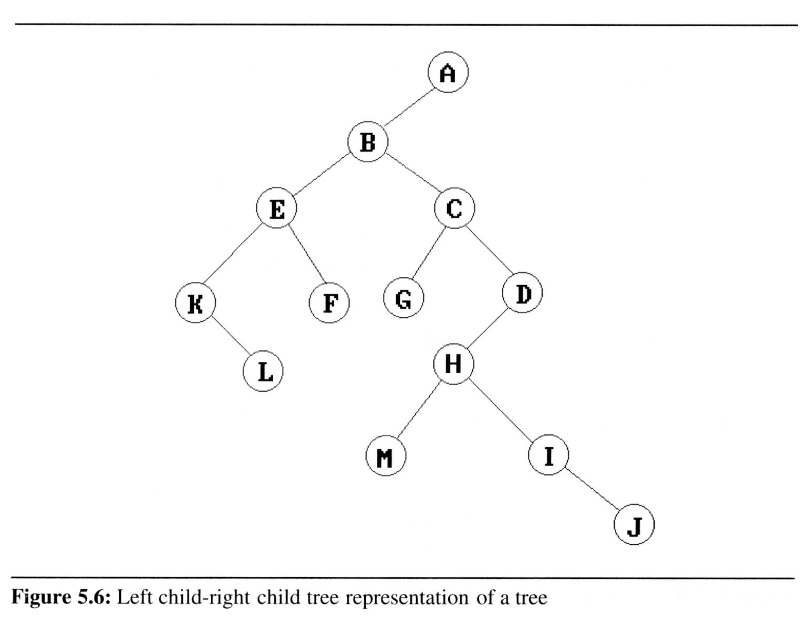
Binary Trees ( Degree two Repr)
This representation is obtained by rotating the right-siblings in a Left-child, Right-sibling Representation by 45 degrees. The degree two tree representation of the above tree is as shown below.

Slide 12
Binary Trees (1/8)
Binary trees are characterized by the fact that any node can have at most two branches
Definition (recursive):
  A binary tree is a finite set of nodes that is either empty or consists of a root and two disjoint binary trees called the left subtree and the right subtree
Thus the left subtree and the right subtree are distinguished
Any tree can be transformed into binary tree
  by left child-right sibling representation
A
A
B
B

Slide 13

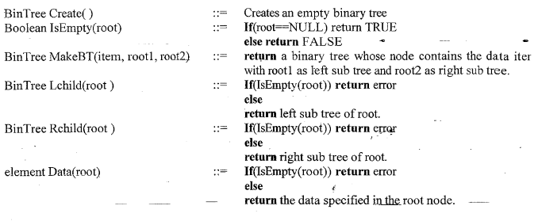
ADT of Binary Tree

Slide 14
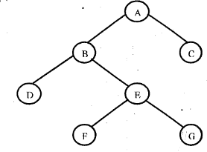
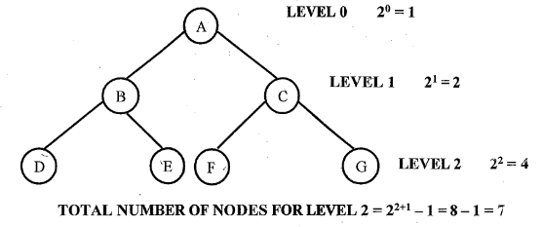
Special kinds of binary trees
Strictly Binary tree:- It is a binary tree in which the out-degree of every node in a tree is either 0 or 2 i.e. every node must have either 2 children or no child.
Full or Complete Binary Tree -It is a binary tree that contains maximum number of nodes at all levels i.e the number of nodes at any level 'i' is 2^{i}.

Slide 15
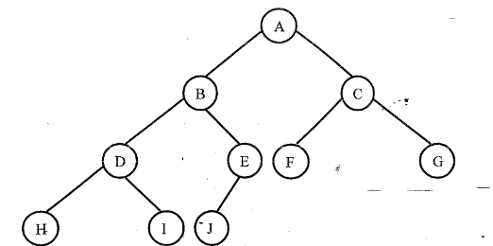
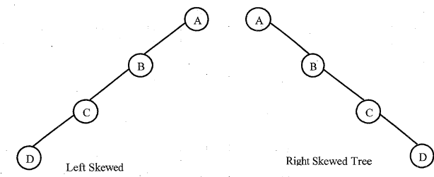
c) Almost Complete Binary Tree- It is a binary tree in which
1. It has maximum possible number of nodes at each level except the last level AND
2. All nodes at the last level should be present only from left to right, if the number of nodes at this level is not the maximum possible.
d) Skewed Tree -A skewed tree is a tree consisting of only left subtree or only right sub tree. A tree with only left subtrees is called as left skewed binary tree and a tree with only right subtree is called right skewed binary tree.
Almost Complete Binary Tree

Slide 16
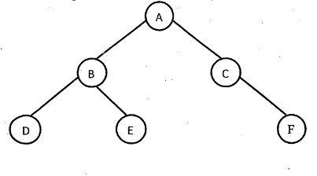
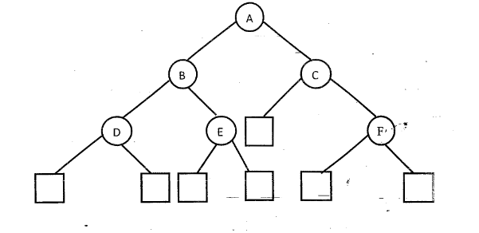
e) Extended Binary Tree or 2-Tree:
A binary tree T is said to be a 2-tree or an extended binary tree if each node N has either 0 or 2 children.
Example : Consider the following binary tree
The extended binary trees for the above binary tress are as shown below.

Slide 17
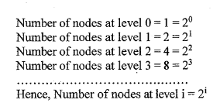
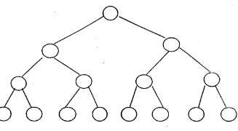
Properties of binary trees
Lemma [Maximum number of nodes]:
  The maximum number of nodes on level i of a binary tree is 2^{i}, i ≥1.
  Proof: Consider the following complete binary tree.

Slide 18
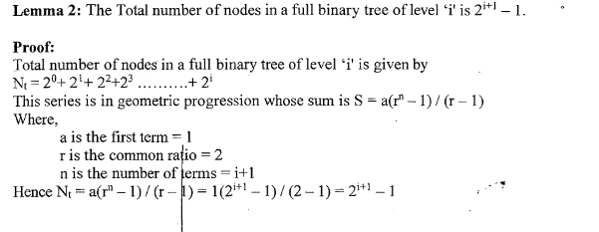

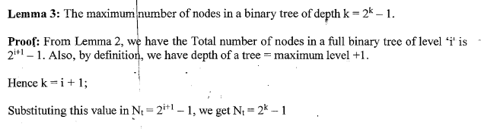

Slide 19
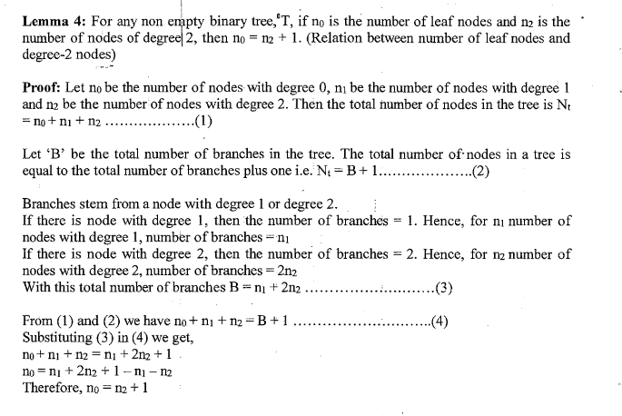

Slide 20
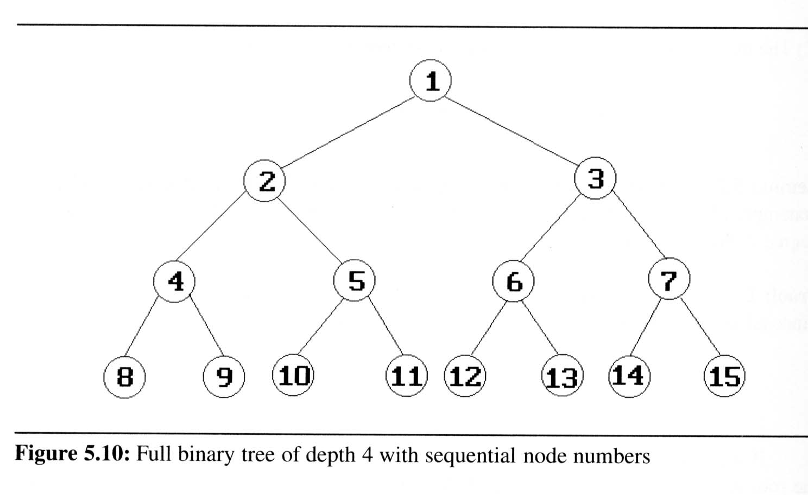
Binary Trees (4/8)
Definition:
  A full binary tree of depth k is a binary tree of death k having 2^{k}-1 nodes, k ≥ 0.
  A binary tree with n nodes and depth k is complete iff its nodes correspond to the nodes numbered from 1 to n in the full binary tree of depth k.
  From Lemma 5.1, the
  height of a complete
  binary tree with n nodes
  is ⎡log₂(n+1)⎤

Slide 21
Binary Tree Representation
Binary trees can be represented using dynamic memory allocation (Linked Representation) or sequential allocation
(Array Representation).
Linked Representation
In this representation, each node in a tree has three fields.
1. info -Contains the actual information
2. llink-Contains the address of left sub tree
3. rlink -Contains the address of right sub tree
So, a node can be represented using the structure as shown below.
struct node
{ int info;
struct node *llink;
struct node *rlink;
};

Slide 22
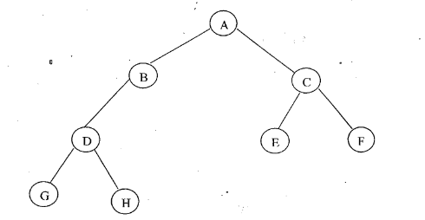
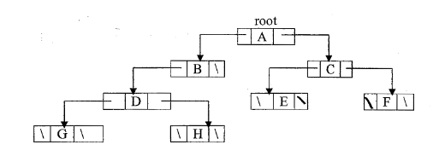
Consider the following tree
Its linked representation
Note: A variable root always points to the root node. If root= NULL, then the tree is empty.

Slide 23
Binary Trees (5/8)
Binary tree representations (using array)
Lemma: If a complete binary tree with n nodes is represented sequentially, then for any node with index i, 1 ≤ i ≤ n, we have
  parent(i) is at ⎣i /2⎦ if i ≠ 1.
  If i = 1, i is at the root and has no parent.
  LeftChild(i) is at 2i if 2i ≤ n.
  If 2i > n, then i has no left child.
  RightChild(i) is at 2i+1 if 2i+1 ≤ n.
  If 2i +1 > n, then i has no left child
A
1
[1]
[2]
[3]
[4]
[5]
[6]
[7]
B
2
C
3
A B C — D — E
Level 1
D
E
Level 2
Level 3
4
5
6
7

Slide 24
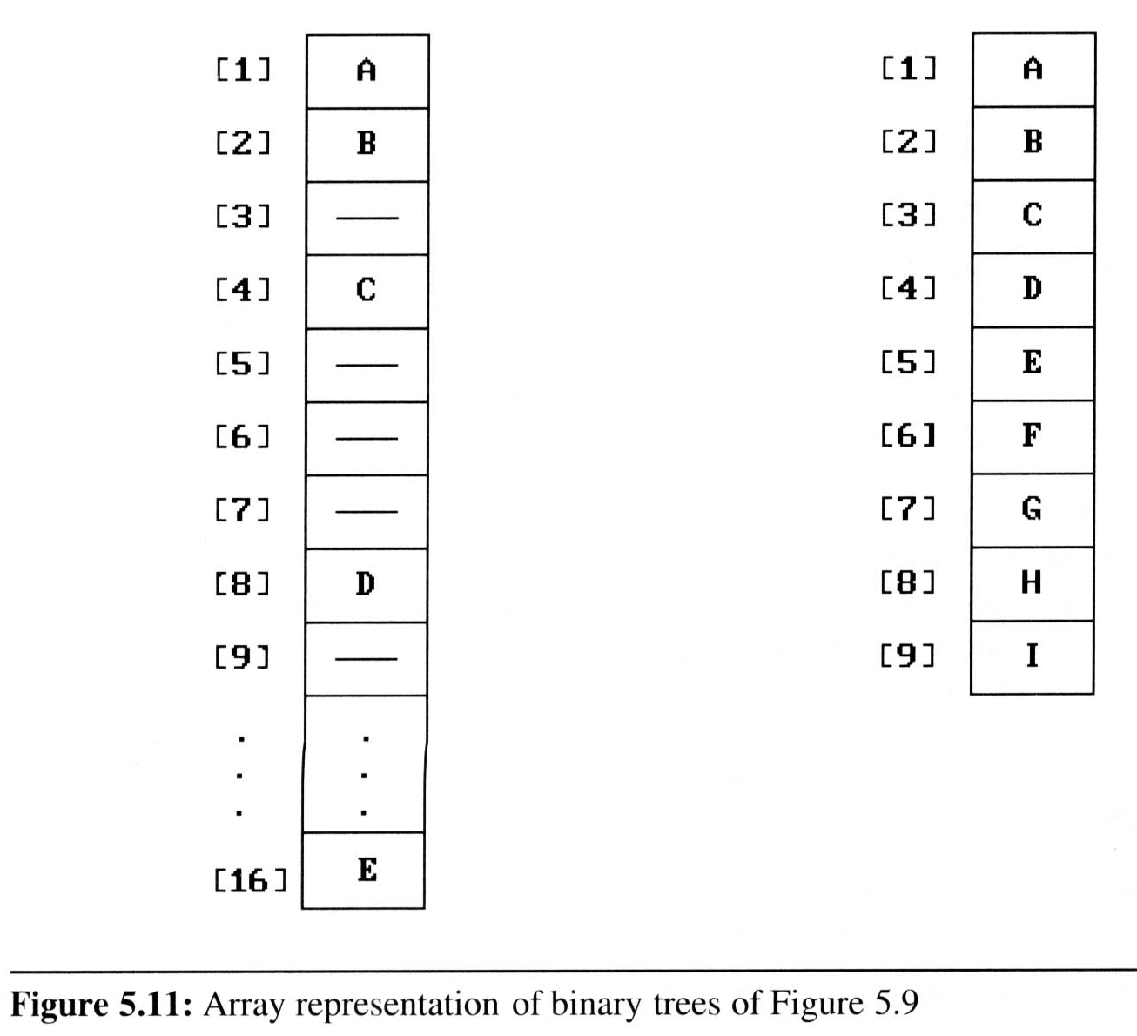
Binary Trees (6/8)
Binary tree representations (using array)
  Waste spaces: in the worst case, a skewed tree of depth k requires 2^{k}-1 spaces. Of these, only k spaces will be occupied
  Insertion or deletion
  of nodes from the
  middle of a tree
  requires the
  movement of
  potentially many nodes
  to reflect the change in
  the level of these nodes

Slide 25

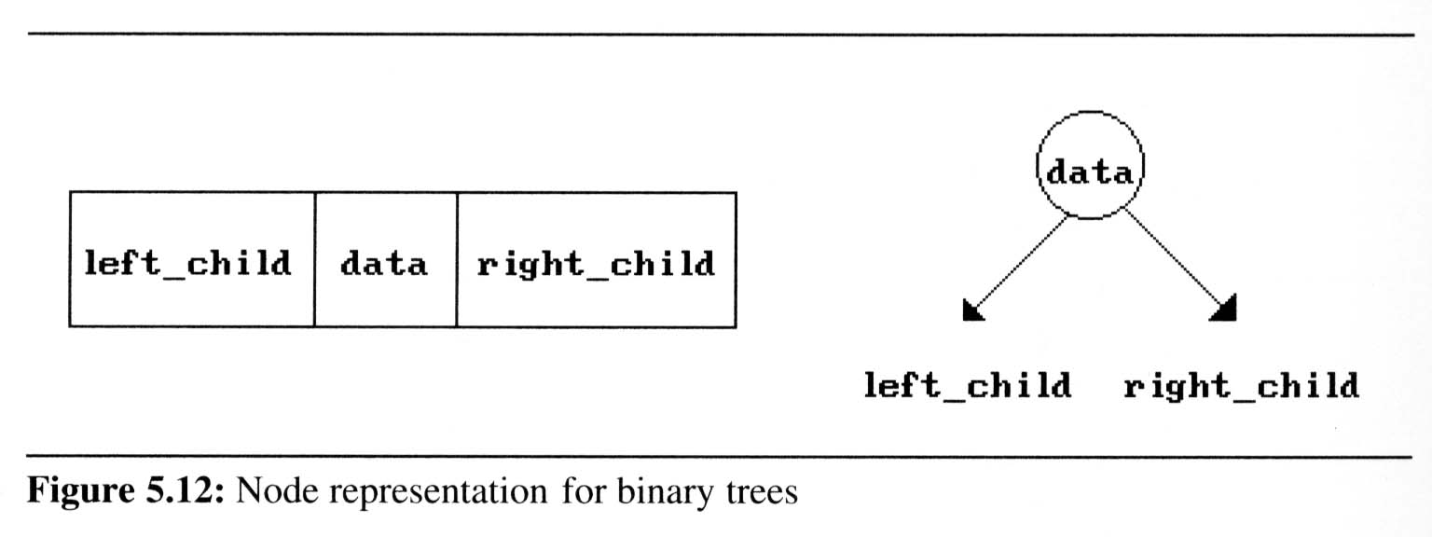
Binary Trees (7/8)
Binary tree representations (using link)

Slide 26
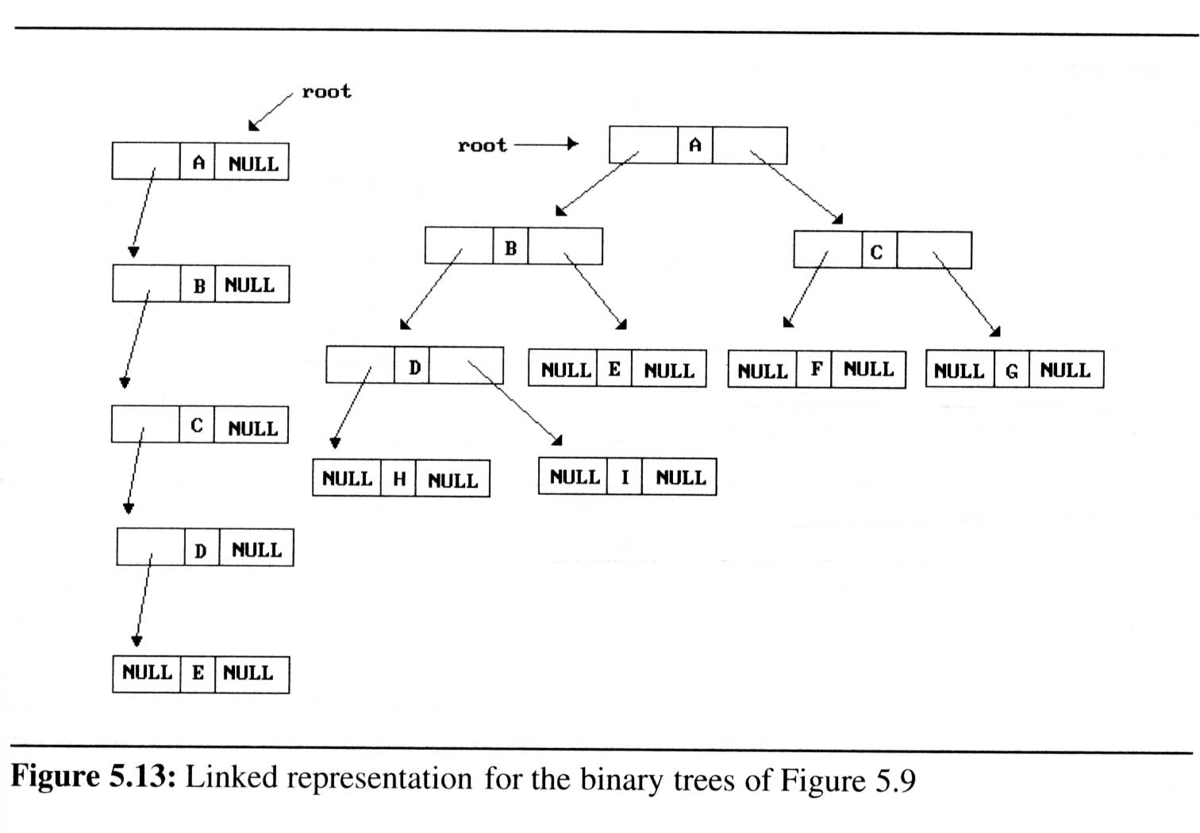
Binary Trees (8/8)
Binary tree representations (using link)

Slide 27
Binary Tree Traversals (1/9)
How to traverse a tree or visit each node in the tree exactly once?
  There are six possible combinations of traversal
LVR, LRV, VLR, VRL, RVL, RLV
  Adopt convention that we traverse left before
  right, only 3 traversals remain
LVR (inorder), LRV (postorder), VLR (preorder)
left_child
data
right_child
V
:
visiting
node
L: moving left
R: moving right

Slide 28
Binary Tree Traversals
1) Pre-Order
  Step 1: Visit the node
  Step 2: Recursively traverse the left subtree in Pre-Order
  Step 3: Recursively traverse the right subtree in Pre-Order
2) In-Order
  Step 1: Recursively traverse the left subtree in In-Order
  Step 2: Visit the node
  Step 3: Recursively traverse the right subtree in In-Order
3) Post-Order
  Step 1: Recursively traverse the left subtree in Post-Order
  Step 2: Recursively traverse the right subtree in Post-Order
  Step 3:,Visit the node

Slide 29
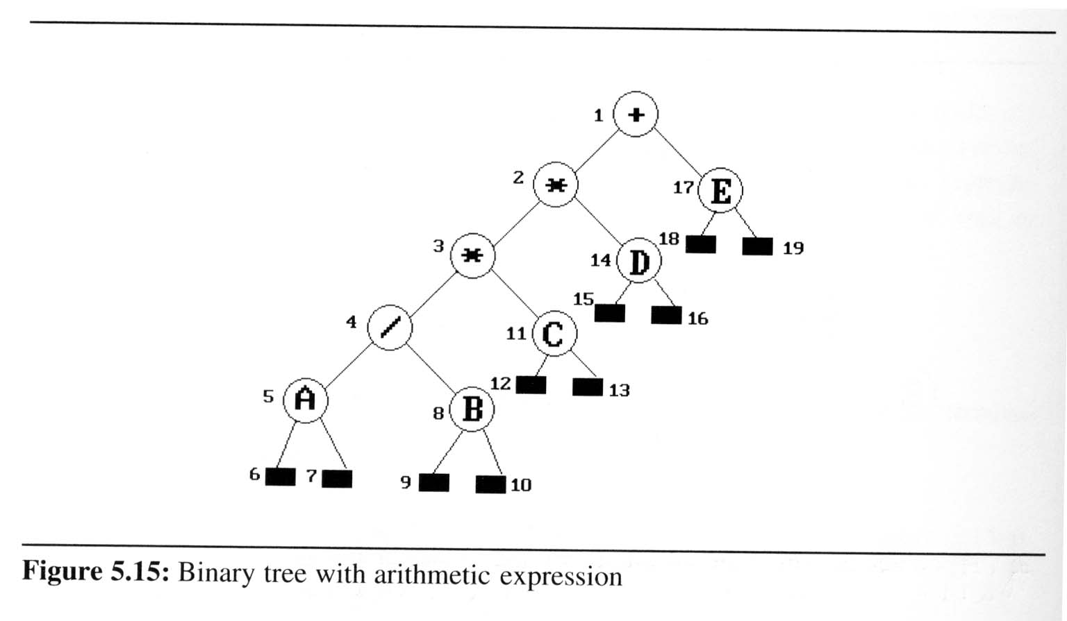
Binary Tree Traversals (2/9)
Arithmetic Expression using binary tree
  inorder traversal (infix expression)
  A / B * C * D + E
  preorder traversal (prefix expression)
  + * * / A B C D E
  postorder traversal
  (postfix expression)
  A B / C * D * E +
  level order traversal
  + * E * D / C A B

Slide 30
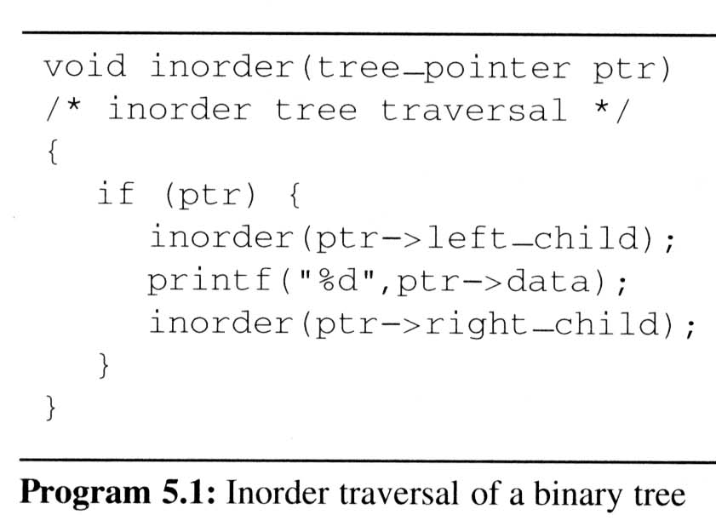
Binary Tree Traversals (3/9)
Inorder traversal (LVR) (recursive version)
output:
A
/
B
*
C
*
D
+
E
ptr
L
V
R

Slide 31
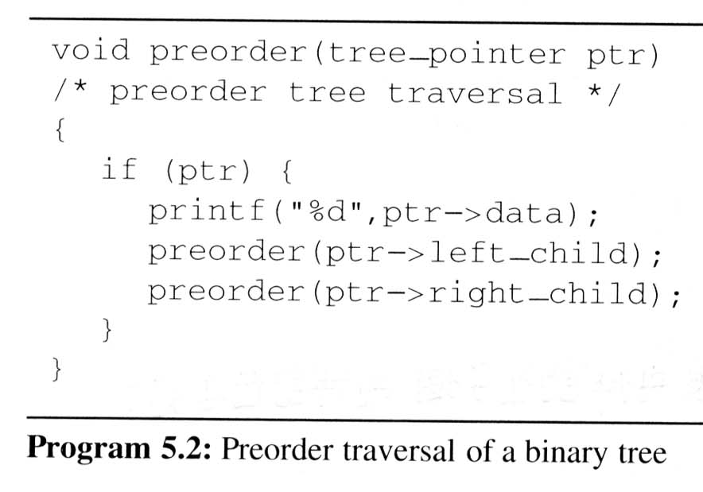
Binary Tree Traversals (4/9)
Preorder traversal (VLR) (recursive version)
output:
+
*
*
/
A
B
C
D
E
V
L
R

Slide 32
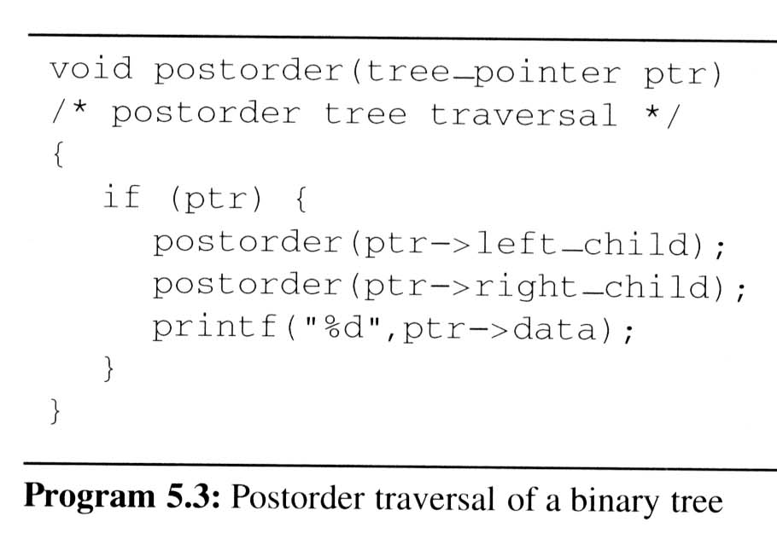
Binary Tree Traversals (5/9)
Postorder traversal (LRV) (recursive version)
output:
A
B
/
C
*
D
*
E
+
L
R
V

Slide 33
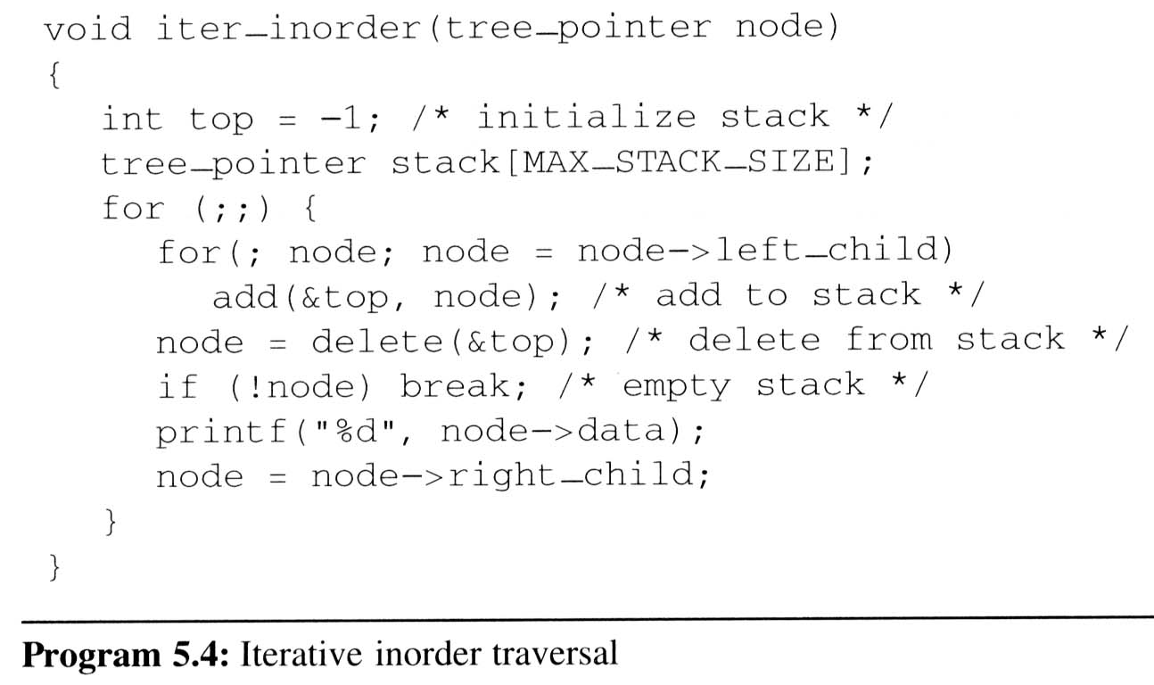
Binary Tree Traversals (6/9)
Iterative inorder traversal
  we use a stack to simulate recursion
5
4
8
11
3
14
2
17
1
A
/
B
*
C
D
*
E
+
L
V
R
output:
A
/
B
*
C
*
D
+
E
node

Slide 34
Binary Tree Traversals (7/9)
Analysis of inorder2 (Non-recursive Inorder traversal)
  Let n be the number of nodes in the tree
  Time complexity: O(n)
    Every node of the tree is placed on and removed
    from the stack exactly once
  Space complexity: O(n)
    equal to the depth of the tree which
    (skewed tree is the worst case)

Slide 35
Binary Tree Traversals (8/9)
Level-order traversal
  method:
    We visit the root first, then the root’s left child, followed by the root’s right child.
    We continue in this manner, visiting the nodes at each new level from the leftmost node to the rightmost nodes
  This traversal requires a queue to implement

Slide 36
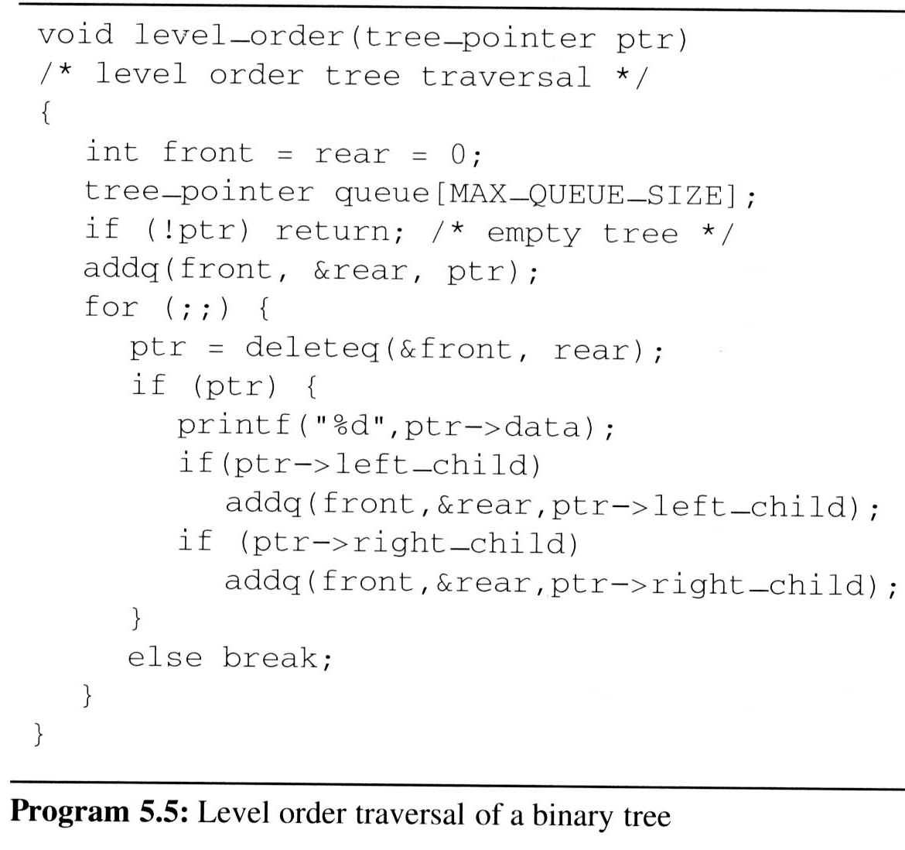
Binary Tree Traversals (9/9)
Level-order traversal (using queue)
output:
+
*
E
*
D
/
C
A
B
1
2
17
3
14
4
11
5
8
+
*
E
*
D
/
C
A
B
FIFO
ptr

Slide 37
Recursive Level order traversal
/*Function to print level order traversal of tree*/ printLevelorder(tree)
for d = 1 to height(tree)
printGivenLevel(tree, d);
/*Function to print all nodes at a given level*/ printGivenLevel(tree, level)
if tree is NULL then return;
if level is 1, then
print(tree->data);
else if level greater than 1, then
printGivenLevel(tree->left, level-1);
printGivenLevel(tree->right, level-1);

Slide 38
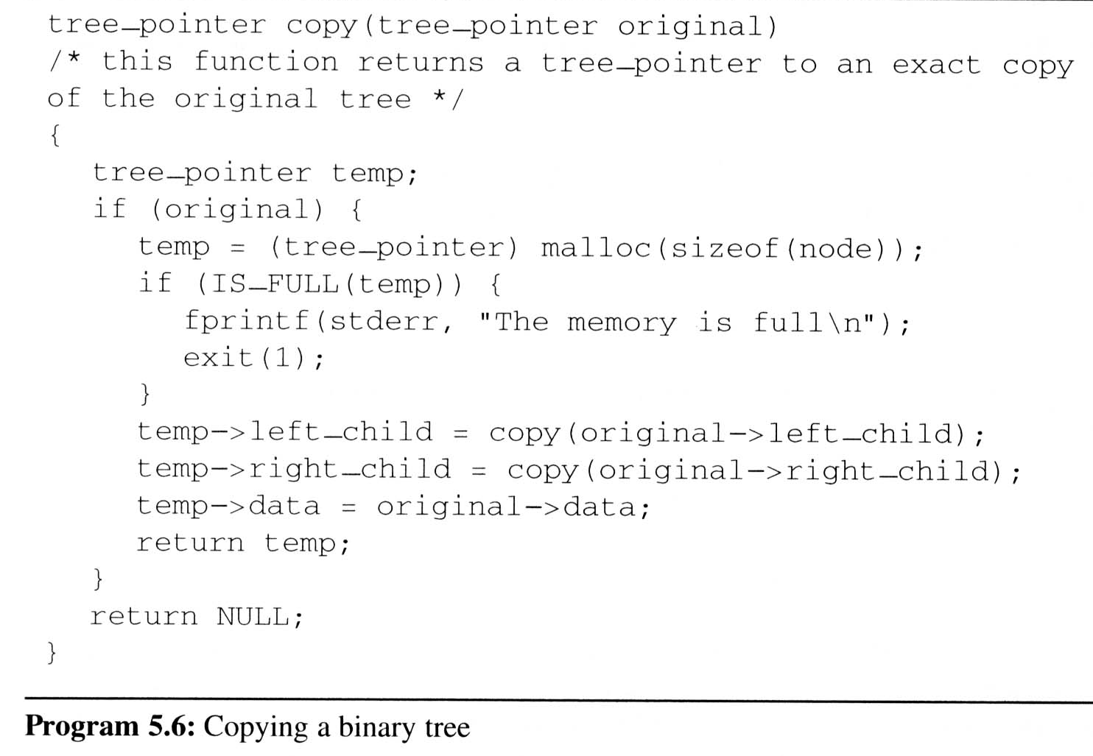


Additional Binary Tree Operations (1/7)
Copying Binary Trees
  we can modify the postorder traversal algorithm slightly to copy the binary tree
similar as Program 5.3

Slide 39
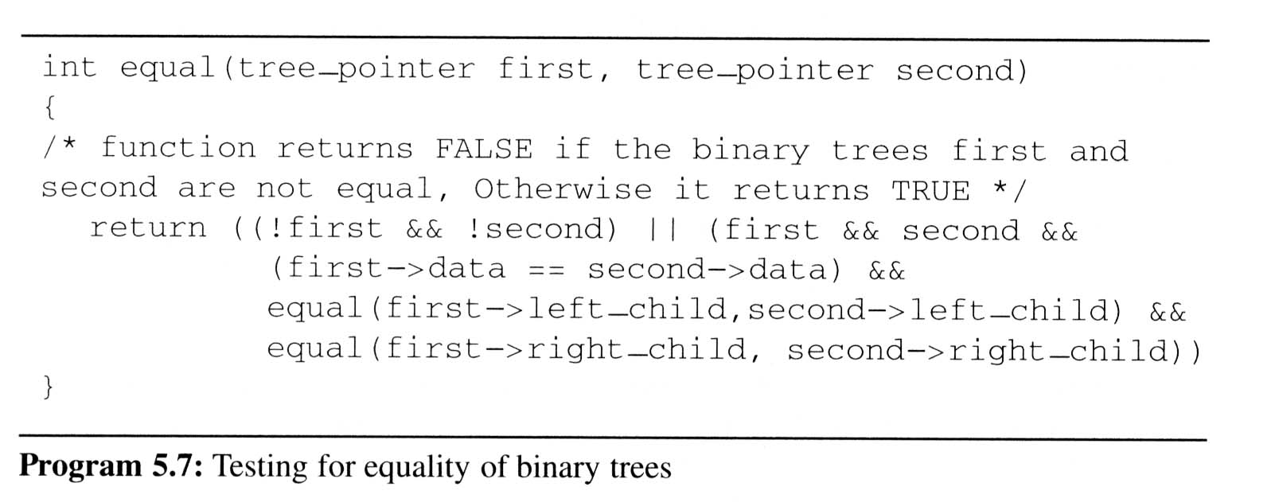
Additional Binary Tree Operations (2/7)
Testing Equality
  Binary trees are equivalent if they have the same topology and the information in corresponding nodes is identical
V
L
R
the same topology and data as Program 5.6

Slide 40
Threaded Binary Trees (1/10)
Threads
  Do you find any drawback of the above tree?
  Too many null pointers in current representation of binary trees
  n: number of nodes
  number of non-null links: n-1
  total links: 2n
  null links: 2n-(n-1) = n+1
  Solution: replace these null pointers with some useful “threads”

Slide 41
Threaded Binary Trees (2/10)
Rules for constructing the threads
  If ptr->left_child is null,
  replace it with a pointer to the node that would be visited before ptr in an inorder traversal
  If ptr->right_child is null,
  replace it with a pointer to the node that would be visited after ptr in an inorder traversal

Slide 42
Threaded Binary Trees (3/10)
A Threaded Binary Tree
root
A
t: true ⇒ thread
f: false ⇒ child
dangling
f
B
f
C
D
t
E
t
F
G
dangling
inorder traversal:
H
I
H D I B E A F C G

Slide 43
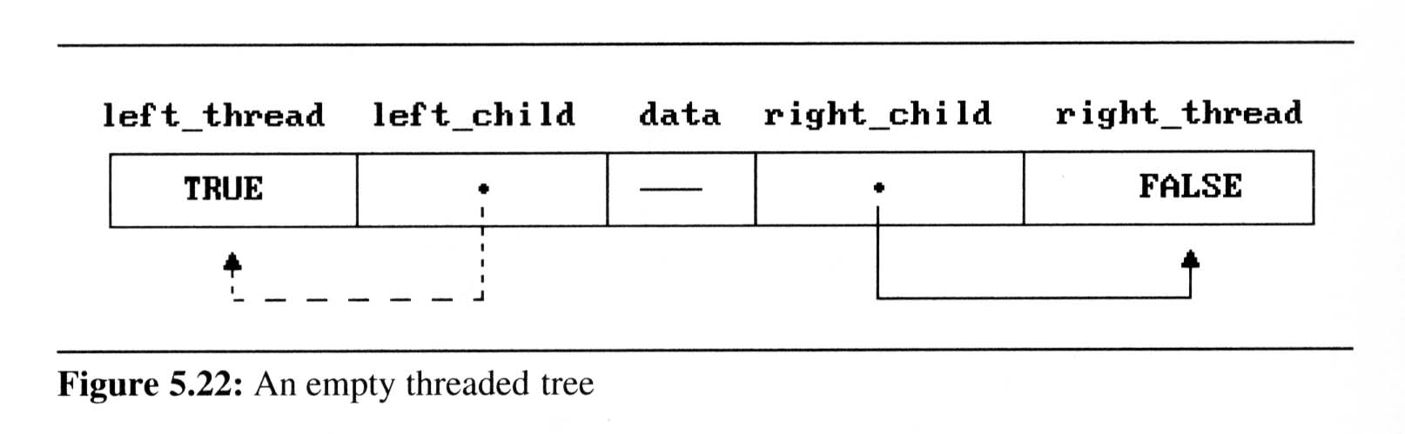
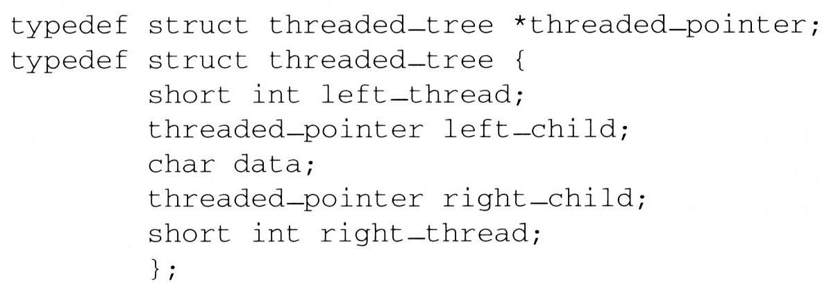
Threaded Binary Trees (4/10)
Two additional fields of the node structure, left-thread and right-thread
  If ptr->left-thread=TRUE,
  then ptr->left-child contains a thread;
  Otherwise it contains a pointer to the left child.
  Similarly for the right-thread

Slide 44
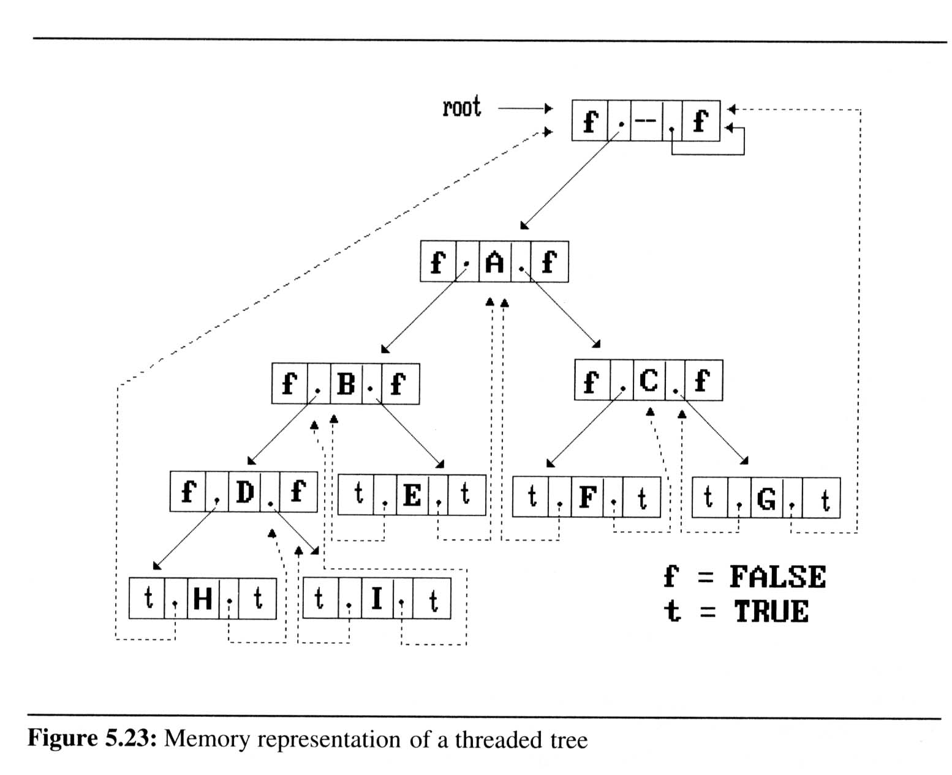
Threaded Binary Trees (5/10)
If we don’t want the left pointer of H and the right pointer of G to be dangling pointers, we may create root node and assign them pointing to the root node

Slide 45
Threaded Binary Trees (6/10)
Inorder traversal of a threaded binary tree
  By using of threads we can perform an inorder traversal without making use of a stack (simplifying the task)
  Now, we can follow the thread of any node, ptr, to the “next” node of inorder traversal
  If ptr->right_thread = TRUE, the inorder successor of ptr is ptr->right_child by definition of the threads
  Otherwise we obtain the inorder successor of ptr by following a path of left-child links from the right-child of ptr until we reach a node with left_thread = TRUE

Slide 46
Threaded Binary Trees (7/10)
Finding the inorder successor (next node) of a node
  threaded_pointer insucc(threaded_pointer tree){
  threaded_pointer temp;
  temp = tree->right_child;
  if (!tree->right_thread)
  while (!temp->left_thread)
  temp = temp->left_child;
  return temp;
  }
tree
temp
Inorder

Slide 47
Threaded Binary Trees (8/10)
Inorder traversal of a threaded binary tree
  void tinorder(threaded_pointer tree){
  /* traverse the threaded binary tree inorder */
  threaded_pointer temp = tree;
  for (;;) {
  temp = insucc(temp);
  if (temp==tree)
  break;
  printf(“%3c”,temp->data);
  }
  }
output:
H
D
I
B
E
A
F
C
G
tree
Time Complexity: O(n)

Slide 48
Threaded Binary Trees (9/10)
Inserting A Node Into A Threaded Binary Tree
  Insert child as the right child of node parent
  change parent->right_thread to FALSE
  set child->left_thread and child->right_thread to TRUE
  set child->left_child to point to parent
  set child->right_child to parent->right_child
  change parent->right_child to point to child

Slide 49
Threaded Binary Trees (10/10)
Right insertion in a threaded binary tree
  void insert_right(thread_pointer parent, threaded_pointer child){
  /* insert child as the right child of parent in a threaded binary tree */
  threaded_pointer temp;
  child->right_child = parent->right_child;
  child->right_thread = parent->right_thread;
  child->left_child = parent;
  child->left_thread = TRUE;
  parent->right_child = child;
  parent->right_thread = FALSE;
  If(!child->right_thread){
  temp = insucc(child);
  temp->left_child = child;
  }
  }
root
A
parent
B
C
X
child
parent
temp
A
B
child
X
C
D
First Case
Second Case
E
F
successor

Slide 50
Binary Search Trees (1/8)
Definition of binary search tree:
A binary search tree is a binary tree. It may be empty. If it is now empty, then it satisfies the following properties.
1) Each node has exactly one key and the keys in the tree are distinct.
2) The keys (if any) in the left subtree are smaller than the key in the root.
3) The keys (if any) in the right subtree are larger than the key in the root.
4) The left and right subtrees are also binary search tree's.

Slide 51
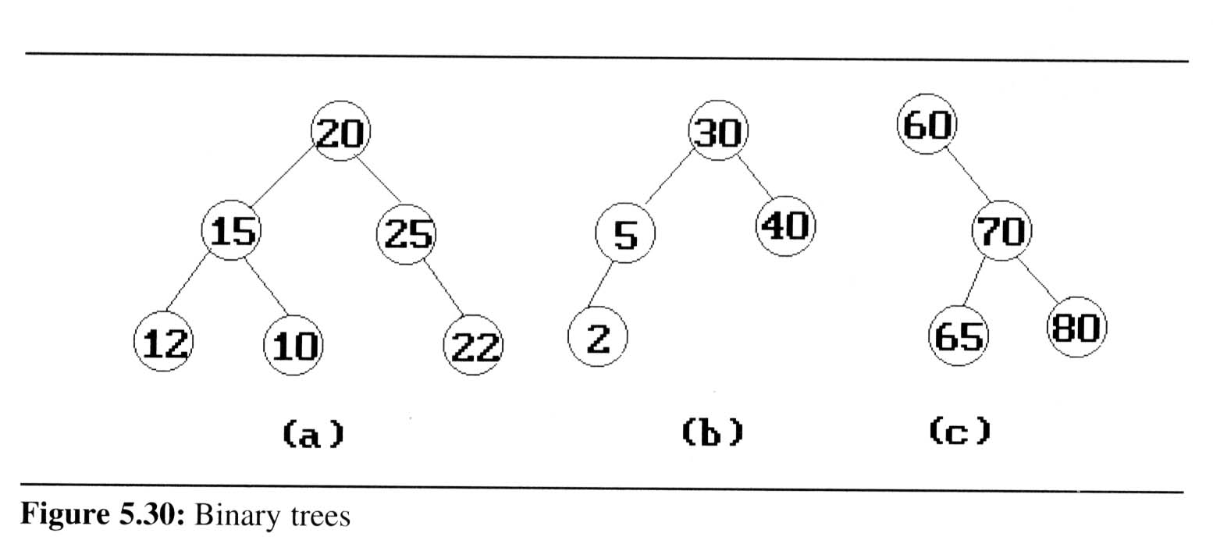
Binary Search Trees (2/8)
Example: (b) and (c) are binary search trees
medium
smaller
larger

Slide 52
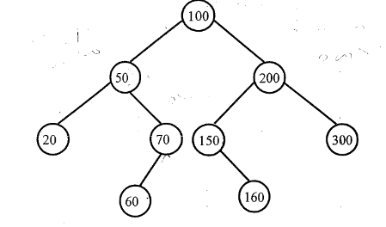
Binary search Traversals
Inorder
Preorder
Postorder

Slide 53
inorder
20,50,60, 70, 10Q, 150,160,200,300
Preorder
100,50,20, 70,6.0,200, 150,160,300
Postorder
20,60,70,50, 160,150,300,208,100
Note:
Inorder traversal on a binary search tree will give sorted order of data in ascending order. This method of sorting is known as binary sort.

Slide 54
Binary Search Trees (3/8)
Search:
Search(25)
Search(76)
44
17
88
32
65
97
28
54
82
29
76
80

Slide 55
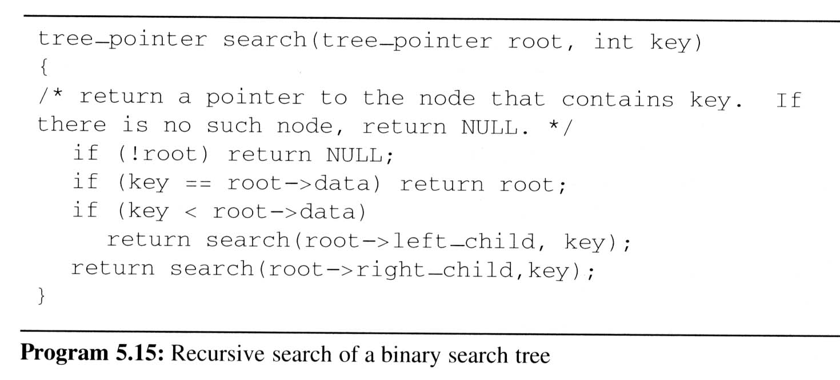
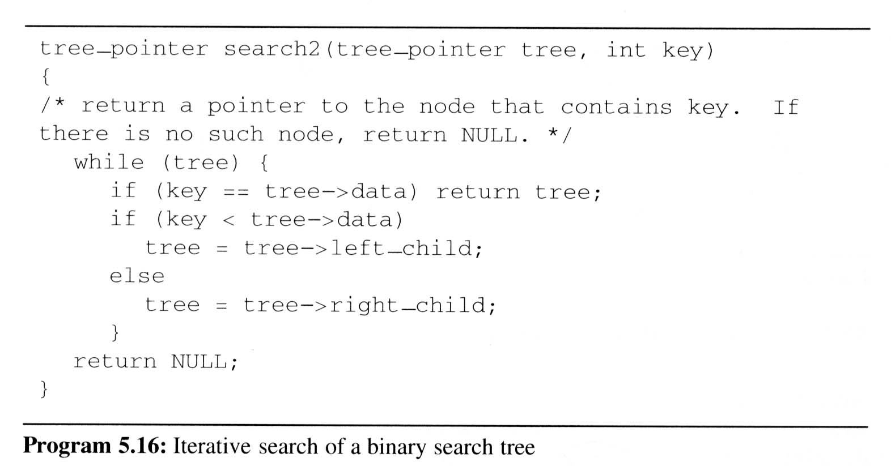
Binary Search Trees (4/8)
Searching a
binary search
tree
O(h)

Slide 56
Creating or inserting an element in a BST
22,17, 25, 6, 21, 19, 24, 36, 30

Slide 57
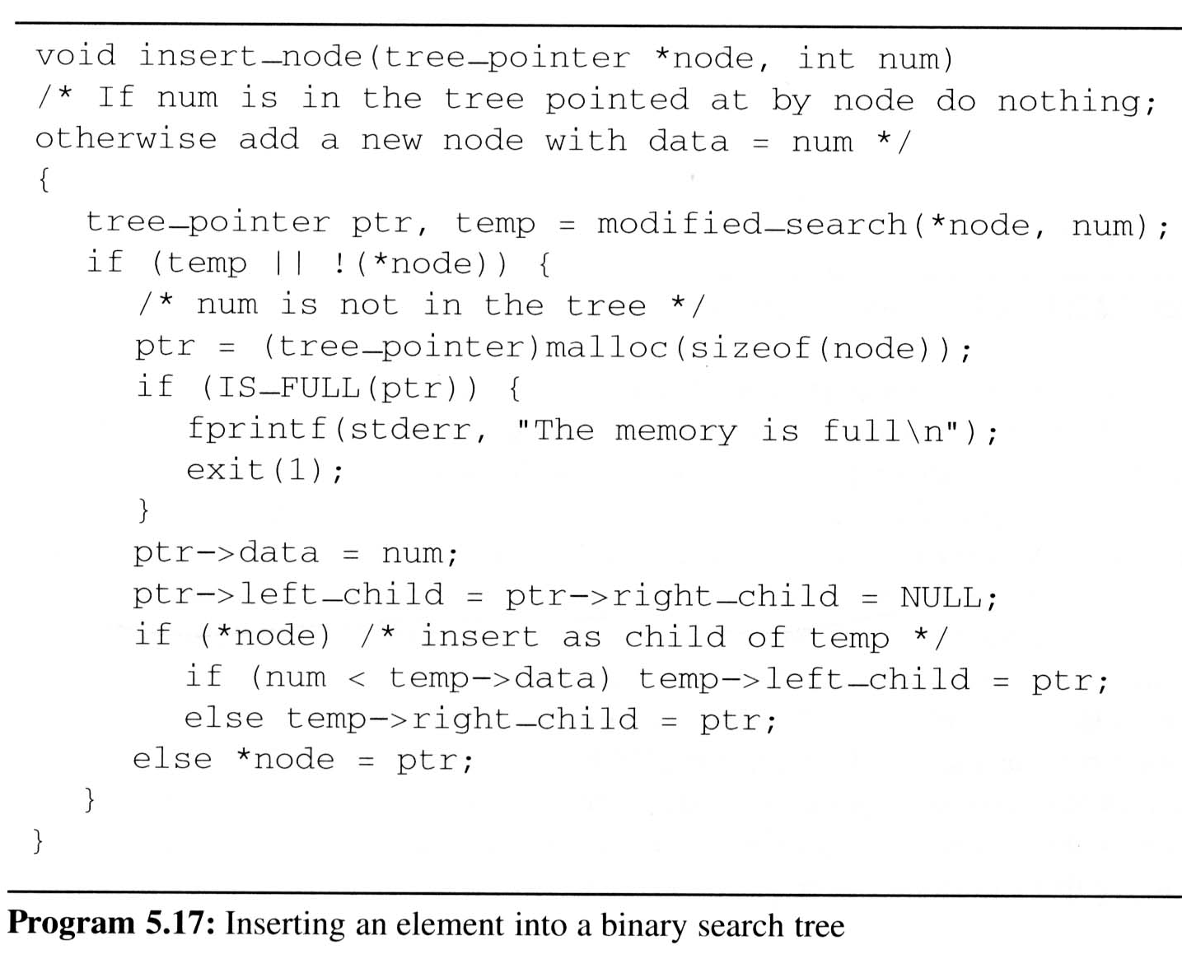
Binary Search Trees (5/8)
Inserting into a binary search tree
An empty tree

Slide 58
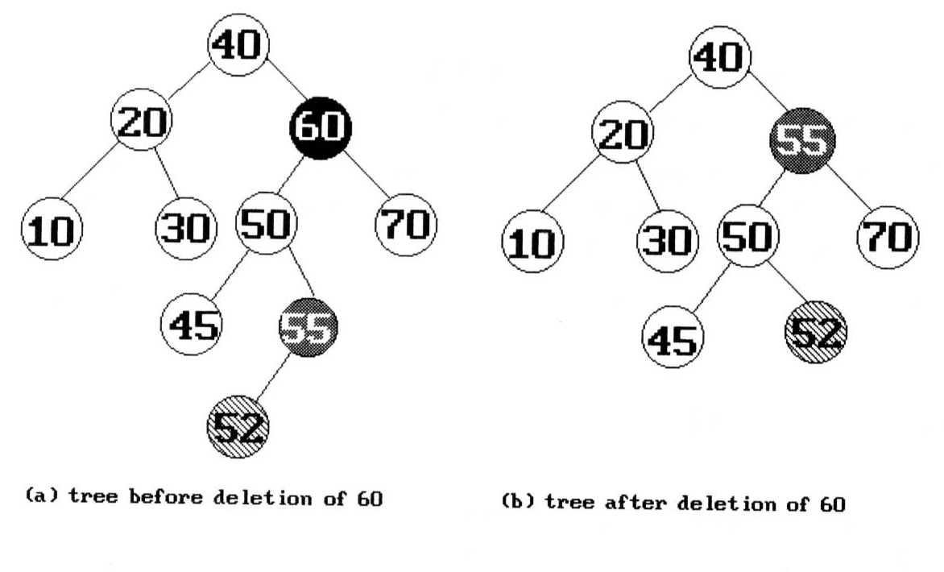
Binary Search Trees (6/8)
Deletion from a binary search tree
  Three cases should be considered
  case 1. leaf → delete
  case 2. one child → delete and change the pointer to this child
  case 3. two child → either the smallest element in the right subtree or the largest element in the left subtree

Slide 59
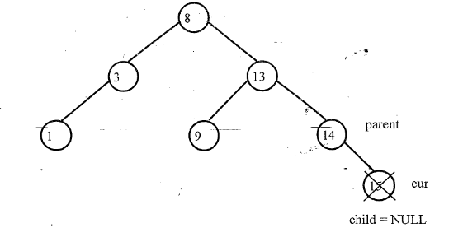
Case 1: Node to be deleted (cur) has no children.
No adjustments is needed except to make parents right link as NULL as in this example.
If( cur == par->llink)
par-> llink=child;
else
par->rlink=child;
free( cur);

Slide 60
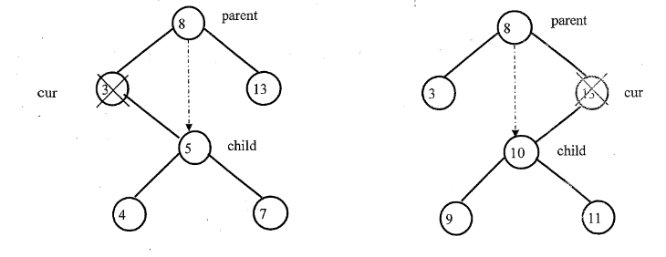
Case 2: Node to be deleted (cur) has only one-subtree
If(cur->llink ==NULL)
child = cur->rlink;
else if( cur->rlink =NULL)
child = cur->llink;
If( cur == par->llink)
par-> llink=child;
else
par->rlink=child;
free( cur);

Slide 61
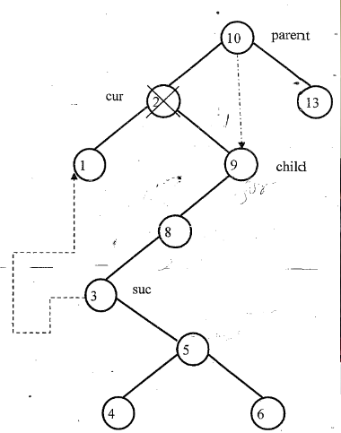
Case:3: Node to be deleted (cur) has both subtrees
//Find the child
child = cur->rlink;
// Find the inorder successor and make left subtree of cur as left subtree of successor
suc= cur->rlink;
while(suc->llink !=NULL)
{
suc-= suc->llink;
}
suc->llink = cur->llink;
//establish links and delete
If( cur == par->llink)
par-> llink=child;
else
par->rlink=child;
free( cur);

Slide 62
Binary Search Trees (7/8)
Height of a binary search tree
  The height of a binary search tree with n elements can become as large as n.
  It can be shown that when insertions and deletions are made at random, the height of the binary search tree is O(log₂n) on the average.
  Search trees with a worst-case height of O(log₂n) are called balance search trees

Slide 63
Binary Search Trees (8/8)
Time Complexity
  Searching, insertion, removal
    O(h), where h is the height of the tree
  Worst case - skewed binary tree
    O(n), where n is the # of internal nodes
Prevent worst case
  rebalancing scheme
  AVL, 2-3, and Red-black tree

